Slide 1
Database
RDS, Aurora, Elasticache
AWS Certified Solutions Architect– Professional (SAP-C01)
Study notes - Sep’2019

Slide 2
RDS

Slide 3
RDS Multi-AZ Deployments and Read Replicas
https://www.percona.com/blog/2018/08/02/amazon-rds-multi-az-deployments-read-replicas/
https://aws.amazon.com/about-aws/whats-new/2018/01/amazon-rds-read-replicas-now-support-multi-az-deployments/
Multi-AZ deploment
RDS provides HA and failover support for DB instances using Multi-AZ deployments. It automatically provisions and maintains a synchronous standby replica of the master DB in a different AZ to provide data redundancy, failover support and to minimize latency during system backups.
Benefits of Multi-AZ deployment:
Replication to a standby replica is synchronous
AUTO FAILOVER in case:
The primary DB instance fails
An Availability Zone outage
The DB instance server type is changed
OS patching.
Manual failover initiated
The endpoint of the DB instance remains the same after a failover, the application can resume database operations without manual intervention.
If a failure occurs, your availability impact is limited to the time that the automatic failover takes to complete. This helps to achieve increased availability.
It reduces the impact of maintenance.
Can I use an RDS standby replica for read scaling?
The Multi-AZ deployments are not a read scaling solution, you cannot use a standby replica to serve read traffic. Multi-AZ maintains a standby replica for HA/failover. It is available for use only when RDS promotes the standby instance as the primary. To service read-only traffic, you should use a Read Replica instead.
Read Replicas
Read replicas allow you to have a read-only copy of your DB.
When you create a Read Replica, you first specify an existing DB instance as the source. Then RDS takes a snapshot of the source instance and creates a read-only instance from the snapshot. You can use MySQL native asynchronous replication to keep Read Replica up-to-date with the changes. The source DB must have automatic backups enabled for setting up read replica.
Benefits of Read Replicas:
Read Replica helps in decreasing load on the primary DB by serving read-only traffic.
A Read Replica can be manually promoted as a standalone DB instance.
You can create Read Replicas within AZ, Cross-AZ or Cross-Region.
You can have up to five Read Replicas per master, each with own DNS endpoint. Unlike a Multi-AZ standby replica, you can connect to each Read Replica and use them for read scaling.
You can have Read Replicas of Read Replicas.
Read Replicas can be Multi-AZ enabled.
You can use Read Replicas to take logical backups (mysqldump/mydumper) if you want to store the backups externally.
Read Replica helps to maintain a copy of databases in a different region for disaster recovery.
Conclusion
While both (Multi-AZ and Read replica) maintain a copy of database but they are different in nature. Use Multi-AZ deployments for High Availability and Read Replica for read scalability. You can further set up a cross-region read replica for disaster recovery.

Slide 4
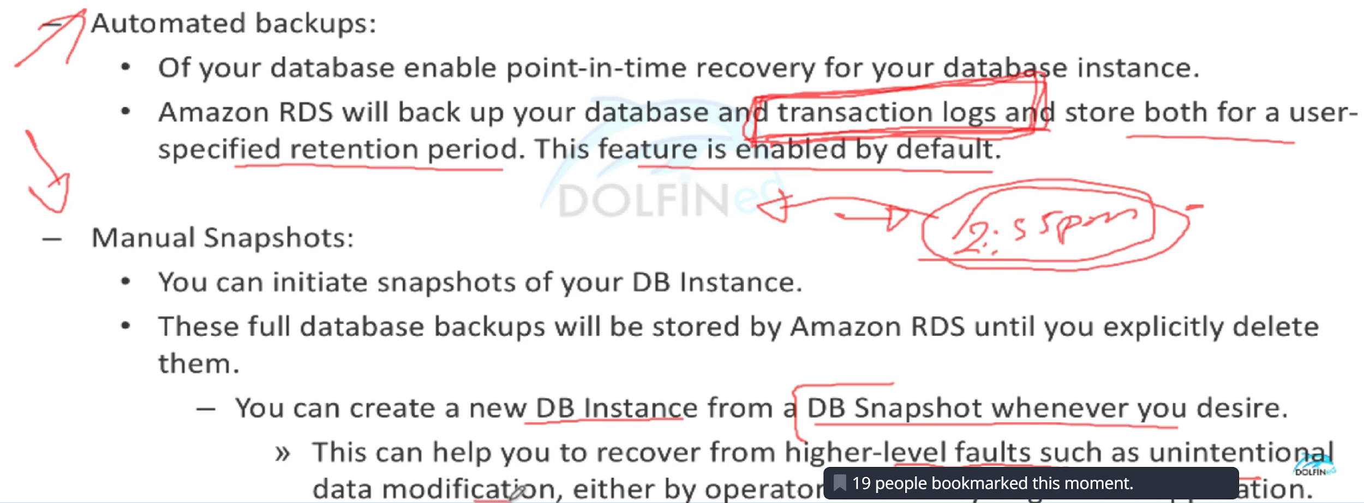
Automated vs Manual backups
No Transaction Logs

Slide 5
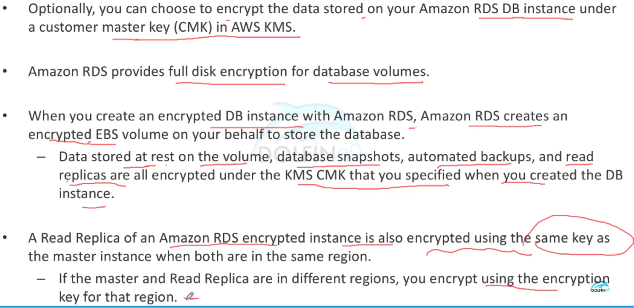
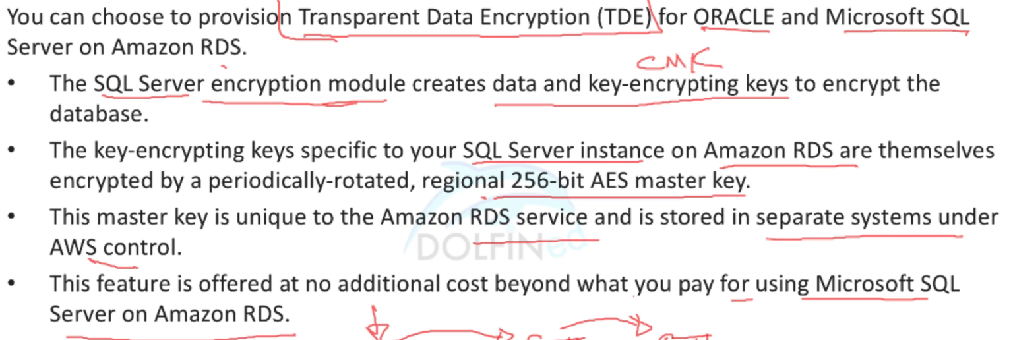
RDS Encryption

Slide 6
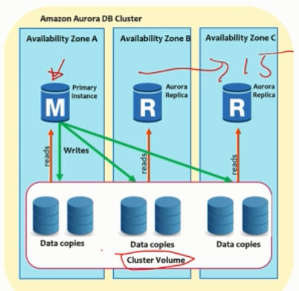
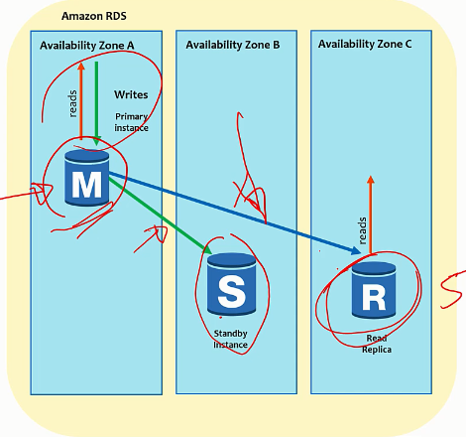
Difference between RDS and Aurora
 | RDS | Aurora
Cluster Architecture | Compute & Volume per instance | Compute per instance, Volume cluster across 3 AZs
Service Type | Regional | Regional
HA | Multi-AZ and/or Read replicas (upto 5) RR Auto promoted on failure | only Read replicas (upto 15) RR Auto promoted on failure
RR sync | ASynchronous | Synchronous
Advantages |  | Cost effective, higher throughput, simple to set up, operate and scale, supports MySQL & PostgresQL
Aurora Connection endpoints
Cluster endpoint
A cluster endpoint for an Aurora DB cluster that connects to the current primary DB instance for that DB cluster. ONLY write operations. Each Aurora DB cluster has one cluster endpoint and one primary DB instance.
Reader endpoint
Connects to one of the available Aurora Replicas for that DB cluster. Each Aurora DB cluster has one reader endpoint. If there is more than one Aurora Replica, the reader endpoint directs each connection request to one of the Aurora Replicas.
Custom endpoint
Represents a set of DB instances that you choose. When you connect to the endpoint, Aurora performs load balancing and chooses one of the instances in the group to handle the connection. You define which instances this endpoint refers to, and you decide what purpose the endpoint serves.
Instance endpoint
An instance endpoint connects to a specific DB instance within an Aurora cluster. Each DB instance in a DB cluster has its own unique instance endpoint. So there is one instance endpoint for the current primary DB instance of the DB cluster, and there is one instance endpoint for each of the Aurora Replicas in the DB cluster.

Slide 7
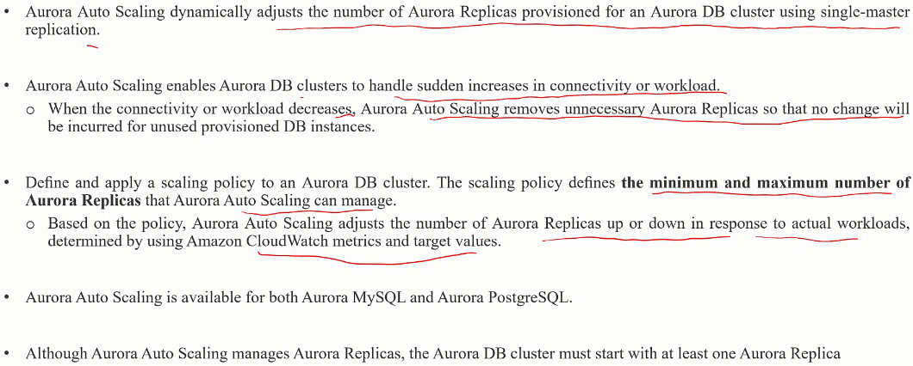
Aurora Autoscaling

Slide 8
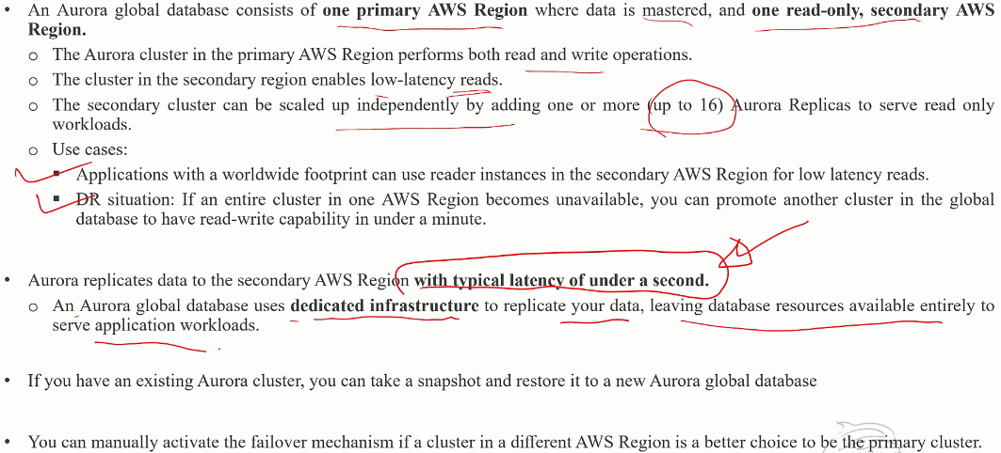
Aurora Global Database

Slide 9
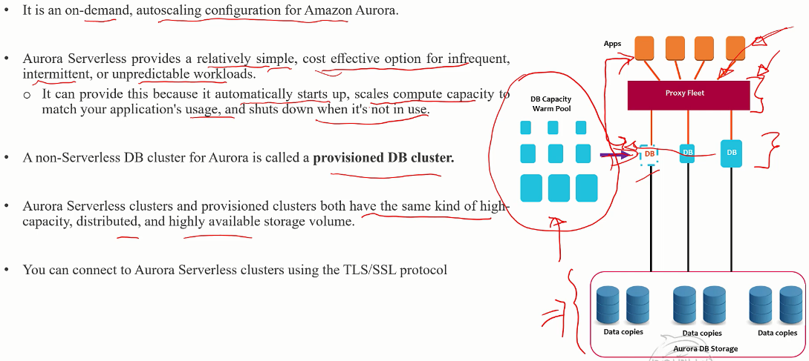
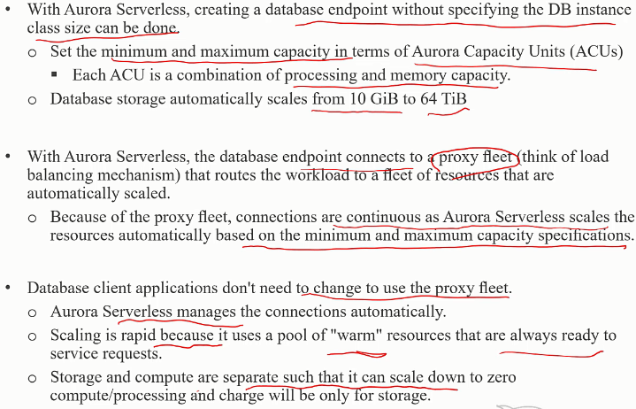
Aurora Serverless
Serverless use cases:
Infrequently used / New applications
Variable workload
Unpredictable workload

Slide 10
Difference b/w RDS MySQL and Aurora MySQL
TL;DR
If you are looking for a native HA solution then you should use Aurora
For a read-intensive workload within an HA environment, Aurora is a perfect match.
To use MySQL plugins you should use RDS MySQL
Aurora only supports InnoDB. If you need other engines i.e. MyISAM, RDS MySQL is the only option
With RDS MySQL you can use specific MySQL releases
AUR has more efficient thread pooling that allows using 5000 concurrent connections, no need of using connection pooling
AUR supports Online & transactional DDL which has much better performance
AUR has better query cache which used to stall MYSQL
Replication:
With Aurora, you can provision up to fifteen replicas compared to just five in RDS MySQL. All Aurora replicas share the same underlying volume with the primary instance and this means that replication can be performed in milliseconds as updates made by the primary instance are instantly available to all Aurora replicas.
HA:
Adding a reader automatically makes Aurora multi-AZ
Failover is automatic with no data loss on Amazon Aurora whereas the replicas failover priority can be set. RDS failover within region (Multi-AZ) is also automatic.
No need of Capacity planning for Aurora as storage increases automatically from 10G to 64TB

Slide 11
DynamoDB

Slide 12
DynamoDB
Fully managed, Unlike RDS, DynamoDB is not launched in your VPC
Provides fully managed Auto scaling & Auto healing
Partition is selected by running a hash function on the specified partition key
Supports Eventual (default) & Strong Read consistency, Application can specify strong
Indexes ALSO has a partition and sort key. Always prefer GSI against LCI unless u need strong consistency
Table -> Items (aka rows) -> Attributes (aka columns). DynamoDB uses primary keys to uniquely identify each item in a table and secondary indexes to provide more querying flexibility. Items are schemaless except for the primary key
Primary Key
Simple primary key (partition key) - unique identifier
Composite primary key (partition & sort key) - partition key + an attribute to be stored in sorted order
Secondary Indexes also has a partition & sort key. lets you query the data in the table using an alternate key, in addition to queries against the primary key. Has 2 types -
Local secondary index - partition key MUST BE SAME as the partition key specified for the table, sort key can be any attribute
Global secondary index - partition key & sort key CAN BE ANY 2 ATTRIBUTES
They can be added on to existing tables (local indexes needs to be created at Create time only!)
They have their own provisioned throughput
ONLY Supports Eventual Read consistency
DynamoDB Streams is an optional feature that captures data modification events in DynamoDB tables. The data about these events appear in the stream in near real time, and in the order that the events occurred. Events - Item Added, Updated, Deleted
RCU and WRU calculation for Provisioned mode -> with a provisioned table with 6 RCUs and 6 WRUs, your application could do the following:
Perform strongly consistent reads of up to 24 KB per second (4 KB × 6 read capacity units).
Perform eventually consistent reads of up to 48 KB per second (twice as much read throughput).
Perform transactional read requests of up to 3 KB per second.
Write up to 6 KB per second (1 KB × 6 write capacity units).
Perform transactional write requests of up to 3 KB per second.
Best practices:
In RDBMS, NORMALIZATION is important, whereas in NoSQL, search and access patterns are most important. Use SORT order. Distribute queries. Use GSI. Use Global Tables for Cross-region data replication., Use partition key that can ensure large # of distinct values compared to # of rows

Slide 13
Using Amazon Aurora Auto Scaling with Aurora Replicas
https://docs.aws.amazon.com/AmazonRDS/latest/AuroraUserGuide/Aurora.Integrating.AutoScaling.html

Slide 14
ElastiCache

Slide 15
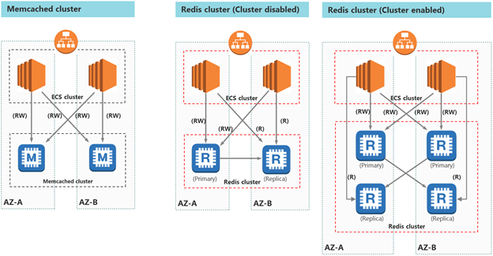
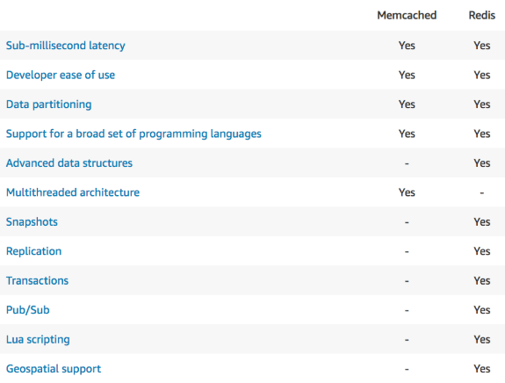
ElastiCache
 | Memcached | Redis (Cluster disabled) | Redis (Cluster enabled)
Data types | Simple | Complex | Complex
Encryption | No | Yes | Yes
Scaling | Yes | Yes | No | Add replica nodes if cluster disabled Cluster mode supports max 15 nodes
Data partitioning | Yes | No | Yes | Cluster supports sharding
High Availability | No No No No No No | Yes Yes Yes Yes Yes Yes | Yes Yes Yes Yes Yes Yes | Redis non-cluster can auto failover by promoting read node to primary node, clients can be unaware of this. Same for cluster mode
Automatic failover
Persistence
Backup & Restore
Sorted list
Geospatial indexing
Fault tolerance options in Redis cluster:
Multi-AZ with Automatic Failover: best option when data retention, minimal downtime, and application performance are a priority.
Data loss potential - Low. Multi-AZ provides fault tolerance for every scenario, including hardware-related issues.
Performance impact - Low. Of the available options, Multi-AZ provides the fastest time to recovery, because there is no manual procedure to follow after the process is implemented.
Cost - Low to high. Multi-AZ is the lowest-cost option. Use Multi-AZ when you can't risk losing data because of hardware failure or you can't afford the downtime required by other options in your response to an outage.
Daily automatic backups
Manual backups using Redis append-only file (AOF)
choose Memcached over Redis if you have the following requirements:
- You need the simplest model possible. - You need to run large nodes with multiple cores or threads. - You need the ability to scale out and in, adding and removing nodes as demand on your system increases and decreases. - You need to cache objects, such as a database.

